Slide 1


Team Project- Group 16
Online- Shop - Computer Parts
Student I: Md Tanvir Azad 21467945
Student II: Remi Tobias 21352892
Student III: Mun Kit Dominic Ling - 21382054
Student IV: Taha Mahmood - 21422699
Student V:Georgi Sharkov - 21438070
Notes:
Title of the presentation and group members are shown on the first slide. The site logo is included in every page.
We are developing an online shop platform that sells computer and other electronic parts from different brands.

Slide 2

Table of Content
Background
Project Management:
Project Scope
Project Plan
Task Allocation
User Requirements
Technical Requirements
Front-End
Back-end
Gantt Chart And WBS
Design
Progress
Notes:
Main points of the presentation slides are included in the table of content page.

Slide 3

Background
Retail Online Shop application
We have a goal to create an online computer parts selling shop with advanced features for different products and brands, with a brief description and searching, sorting, adding to the basket and online payment options.
System needs to be fully functional to offer stocks and different payment methods along with stock control.
Notes:
Online computer parts shop and its core functionalities are included in the background slide. Some of the features are included in this topic. More details will be provided in the next slides.
Main points: Online shop needs to offer:
Different Manufacturers goods
Registration Form for the users
Clear pictures and description of the goods

Slide 4
Project scope
Clear Design
Intuitive Interface
E-
Basket
Cards and other payment options
Login
And
Registration
User Page
Order management
Report's gene
ration
Clear Image and description of the items
Automatic supplies order
Sales tracking
Notes:
We want to achieve in our project user requirements stated above and make a unique online shop platform that will help us to achieve the high sales target and will help flourishing the business.
Advantage of the product will be a simple- easy to understand for all type of user's interface. After discussion, the scope is defined.
Main Design goals:
View items through a gallery of products
Browsing the items
View the details
Registration of the members etc.
Registered members:
Log in
Manage Accounts
My Orders
Checkout
Logout

Slide 5

Project plan
 | SPRINT BACKLOG: Week 1 | GROUP NO: | 16
Task No. | Task Description: | Assigned to: | To be completed by: | Date Uploaded to file exchange area | Notes:
5 | Assigning members roles | All | 28-Feb | 26-Feb
5 | Choosing online shop type | All | 28-Feb | 26-Feb
5 | Logo and name choosing | All | 28-Feb | 26-Feb
5 | Choosing the designing tools | All | 28-Feb | 26-Feb
4 | Discussion about wireframes and technologies | All | 28-Feb | 26-Feb
3a | ER diagram draft for setting up the project | All | 28-Feb | 26-Feb | Lucidchart used
3b | First draft ideas for the design | Taha | 28-Feb | 26-Feb | Adobe XD used
3c | Budgeting the project | Remi | 28-Feb | 26-Feb
3d | Decision about database system | Dominic | 28-Feb | 26-Feb | MySQL chosen
2a | Exploring some database systems (MySQL) | Tanvir | Agreed till 4th week | 4th week | MySQL chosen
2b | Exploring some HTML and CSS systems | Georgi | 3rd week | 3rd week | To be decided
2c | Explore PHP and other IDE supported variants | Georgi | 3rd week | 3rd week | Notepad++ used
1a | Research some modular website creation services | Georgi | 28-Feb | 26-Feb | WIX, Wordpress. Etc
1b | Assigning goals for the next week | Tanvir | 28-Feb | 26-Feb
1c | Full list of user- requirements creation | Tanvir | 28-Feb | 26-Feb | Word Doc created
1d | Research some technical requirements | Taha | 28-Feb |  | Taha needs more time for research
Notes:
Plan of the Project includes the Tasks to be Implemented. Sprint week 1 is included in the plan. It includes Status, prioritisation and tasks assigned to the members. Some of the online tools and specifications are chosen and assigned to the members.

Slide 6
Task allocation
Team Project
Dominic
Md Tanvir
Taha
Remi
Georgi
Project Manager
Design
Team management
Testing
Content creation
Presentation
Documentation
Back End
Meetings
Research
Integration F-B End
QA phase
Front End
Budgeting
Notes:
On this slide all the members are represented along with their tasks with more information about the tasks. Allocation of the stages is completed. Each team member had his role and task to complete.

Slide 7
User Requirements- Front-End
View and Order items
View and Edit Orders
Shopping cart management
Quantity Control
User Registration and Sign in
Different payment methods
Finding Tool
Comparison of the Products
Notes:
Front-End Requirements are listed in this page. There are some additional requirements not included in the slide:
Changing user details
Popular products view
Sales section
Privacy policy
Delivery Options
Customers reviews
Comments Blog

Slide 8
User requirements- back-end
Payment with Cards
New User Creation
Automatic supply orders
Database Management
Users Database
Reports Generation
Product reviews
Stock control
Notes:
Back-End requirements are also very important to be stated in the slide above. Some additional back-end requirements:
User Details Update
View of the orders
Purchase records
Adding products to the database
Modification of the product details
Deletion of the products from the stock
Sales, Discounted products

Slide 9
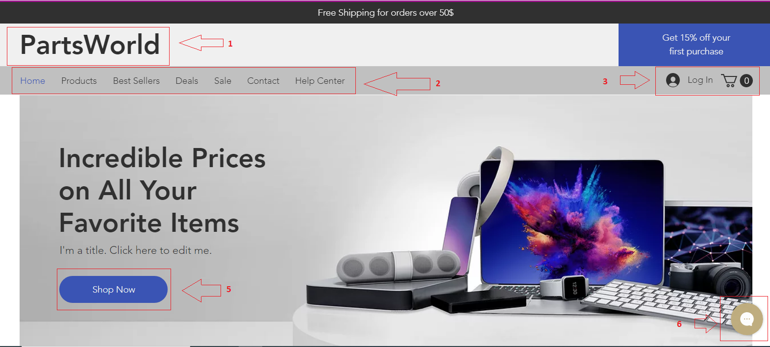
Technical requirements- Front end
Notes:
Main technical requirements for front and back end are shown on this slide. Main features are listed accordingly. Selectors of the products, payment options and description, about us page and contact details are also included. Some of the features included are: Product page has to present the Picture of the product with some information about manufacturer, price, description etc. User will be able to manage the quantity, add items to the basket and delete from it. Page will have the Applied filters for choosing a specific manufacturer or other features. About Us Page will be added along with data protection statement etc.

Slide 10

Technical requirements- Back end
Database for all products
ID numbers, product names and types
Separate tables for:
- Products
- Baskets
- Login Information
- Deliveries etc.
Possibility to search in Database
Filtering
Supplement view
Notes:
In this slide some back-end features are shown. General requirements for the database MYSQL management for the online shop that includes users, suppliers, payments, orders, categories, orders etc. Products included have ID numbers, quantity and price. In addition, it is stated what company supplies the product. Product can be added to the basket that can be seen in the Basket table.

Slide 11
Gannt- chart
Notes:
Using MS Project, Gantt Chart for the whole project is shown in this slide. It includes all tasks and subtasks along with duration and task sequence identification. All expected dates including completion date is given.

Slide 12

Work Breakdown Structure
Notes:
Whole Project is represented along with its main components. It is separated on main and subcomponents. This is the main structure for the team to follow through different tasks completion.

Slide 13
Design-home page

Slide 14
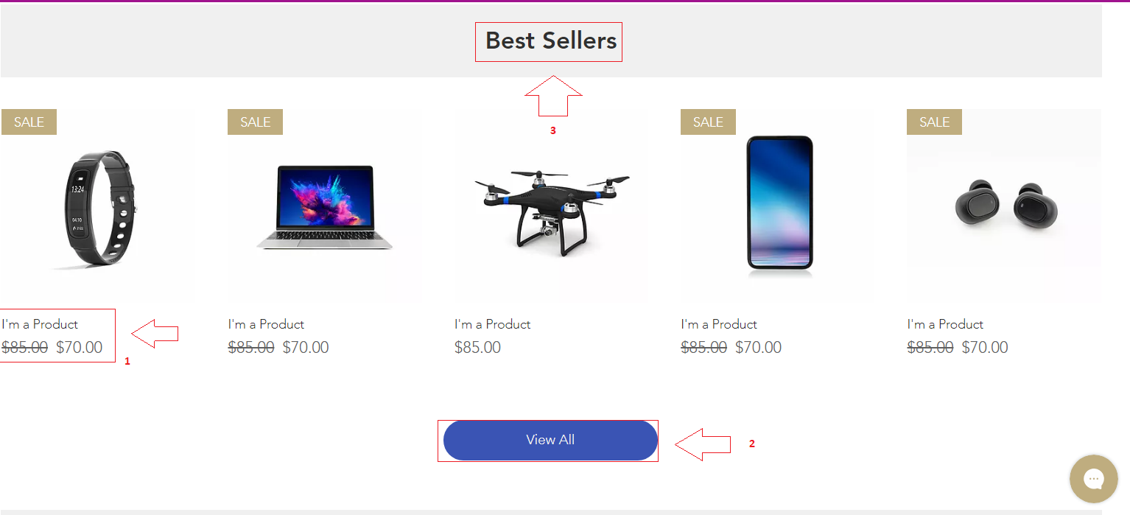
Design
Notes:
In this slide is included the Design of the home page with some features implemented by now. Some annotation are included for the user.

Slide 15
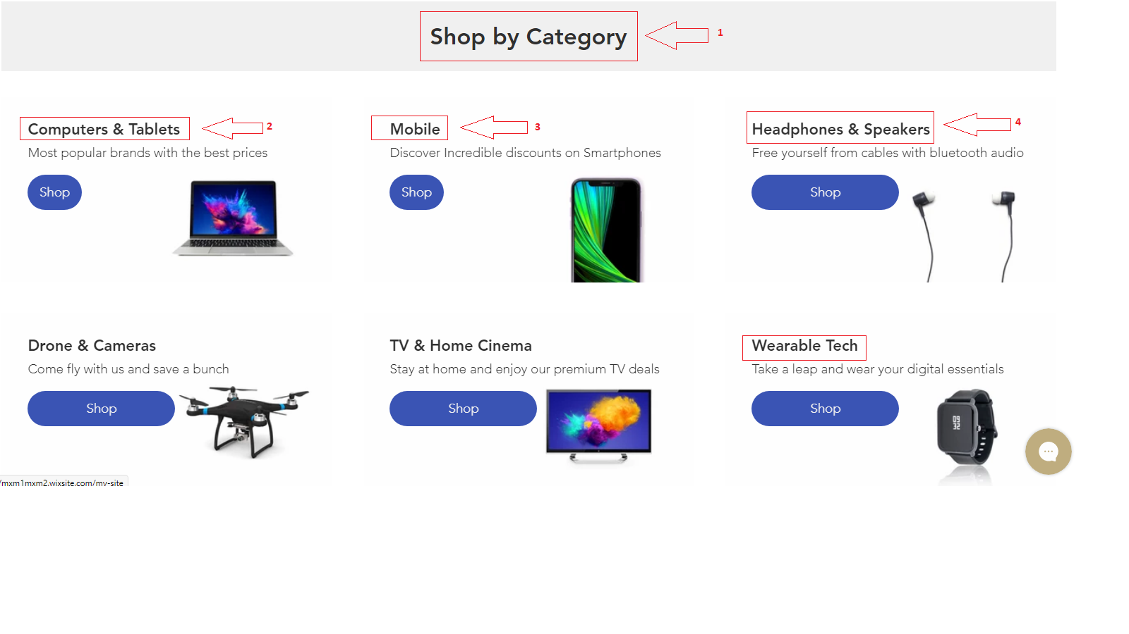
Design- shop by category

Slide 16
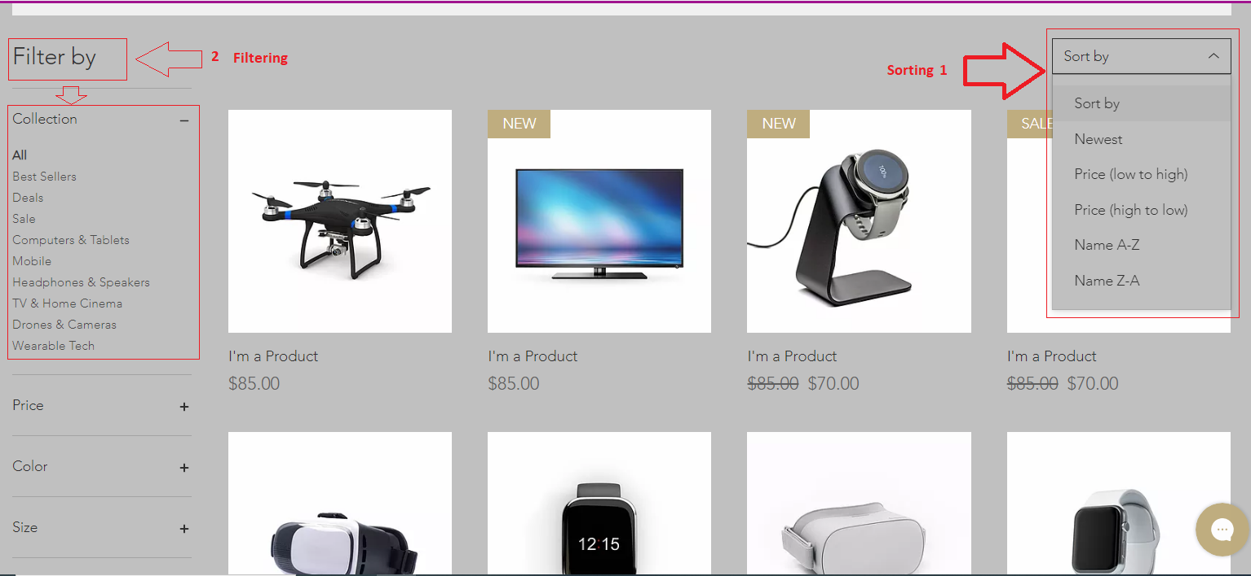
Design-Sorting and filtering

Slide 17
Progress and new tasks allocation
Progress:
Project Plan Management
Requirements (User and Technical)
Task With High Priority
Design of the Website
Database
Product List with details
Product Categories
Allocation of New Tasks
New Tasks:
Admin Page creation
User Page creation
Categories of the items
Details of the Suppliers
Modifications to the Database
Connect Client with server side
Different card payments to be added
Notes:
On this slide is included the Project Progress at the moment of uploading the Presentation and what has been completed so far. Final design will be shown on the later stages. More features to be added.
New Tasks allocation also included in this slide.

Slide 18

Thank you Any questions?

